Slide 1
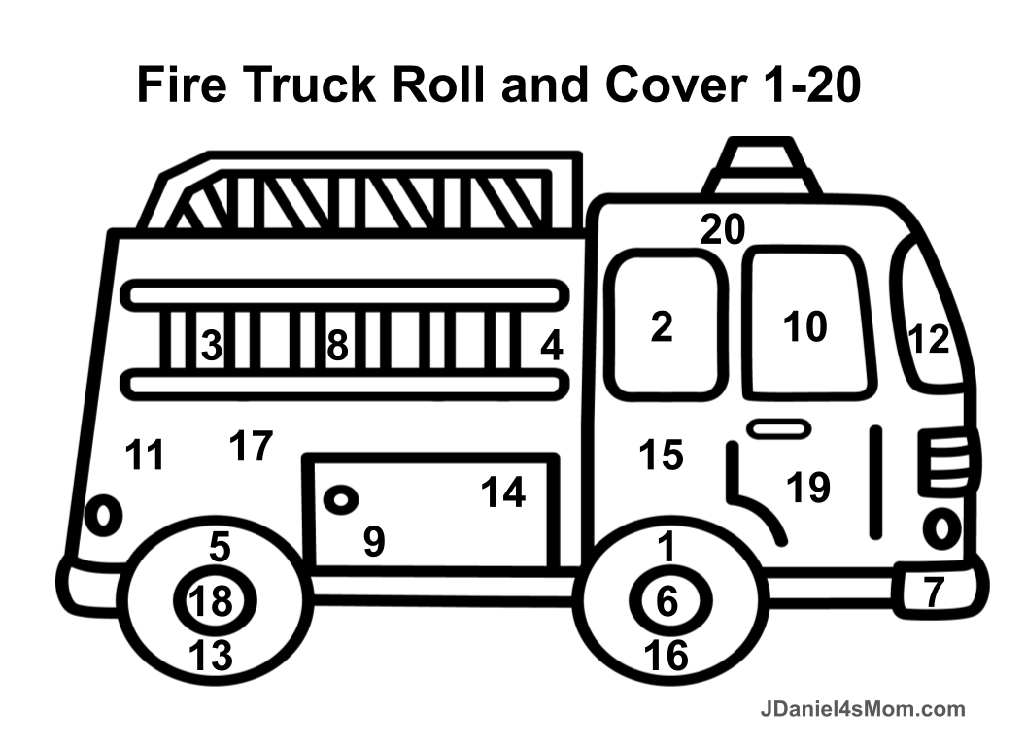
Fire Truck Roll and Cover 1-20
Created by Deirdre Smith of JDaniel4smom
Terms of Use: Remember that all of my worksheets are for personal use. You cannot claim these worksheets or sell them as your own.
All the worksheets are the property of JDaniel4sMom.com

Slide 2
Fire Truck Roll and Cover 1-20
20
2
10
12
3
8
4
11
17
15
14
19
5
9
1
18
6
7
13
16
JDaniel4sMom.com

Slide 3
Thank you for this downloading this set.
I hope your children enjoy this JDaniel4’s Mom resource.
You will find updates on my latest tools on the following:
Instagram: https://www.instagram.com/jdaniel4smom
Facebook: https://www.facebook.com/jdaniel4smom/
Twitter: https://twitter.com/jdaniel4smom?lang=en
Pinterest: https://www.pinterest.com/jdaniel4smom
What is in the set?
Roll and Cover Truck 1-20
Clip Art from :

