Slide 1
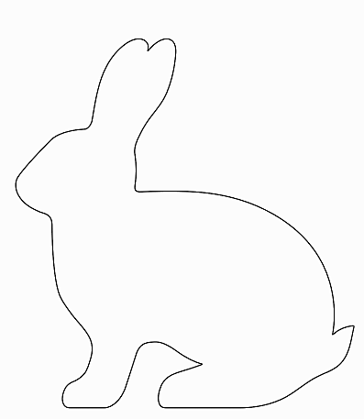
Easter Bunny Template for
Hopping with Chalk Bunnies Activity
Directions: Cut out the bunny outline and trace it onto a piece of rectangular cardboard. Then cut the bunny out of the cardboard leaving an empty bunny outline in the center of the cardboard.

