Slide 1
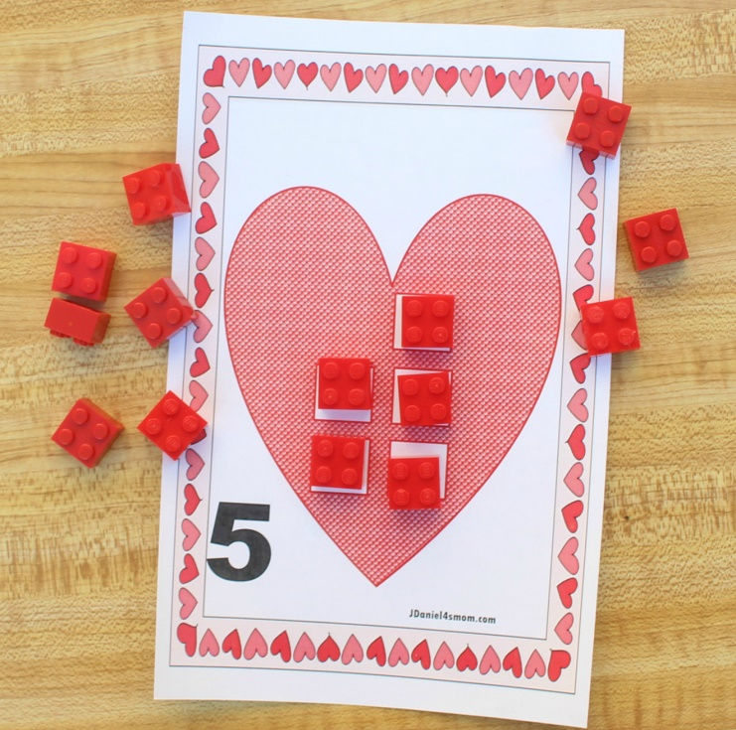
Valentine’s Day STEM LEGO Counting Hearts Created by Deirdre Smith of JDaniel4’s Mom Clip Art from
Terms of Use: These printables are provided FREE of charge. Please do share the web pages to my printables. Remember that all of my printables are for personal use. You cannot claim these printables or sell them as your own. All the printables are the property of JDaniel4sMom.com.

Slide 2
1
2
JDaniel4smom.com
JDaniel4smom.com

Slide 3
3
4
JDaniel4smom.com
JDaniel4smom.com

Slide 4
5
6
JDaniel4smom.com
JDaniel4smom.com

Slide 5
v
v
v
v
v
v
7
8
JDaniel4smom.com
JDaniel4smom.com

Slide 6
v
v
v
v
v
v
9
10
JDaniel4smom.com
JDaniel4smom.com

Slide 7
9
10
JDaniel4smom.com
JDaniel4smom.com

