Slide 1
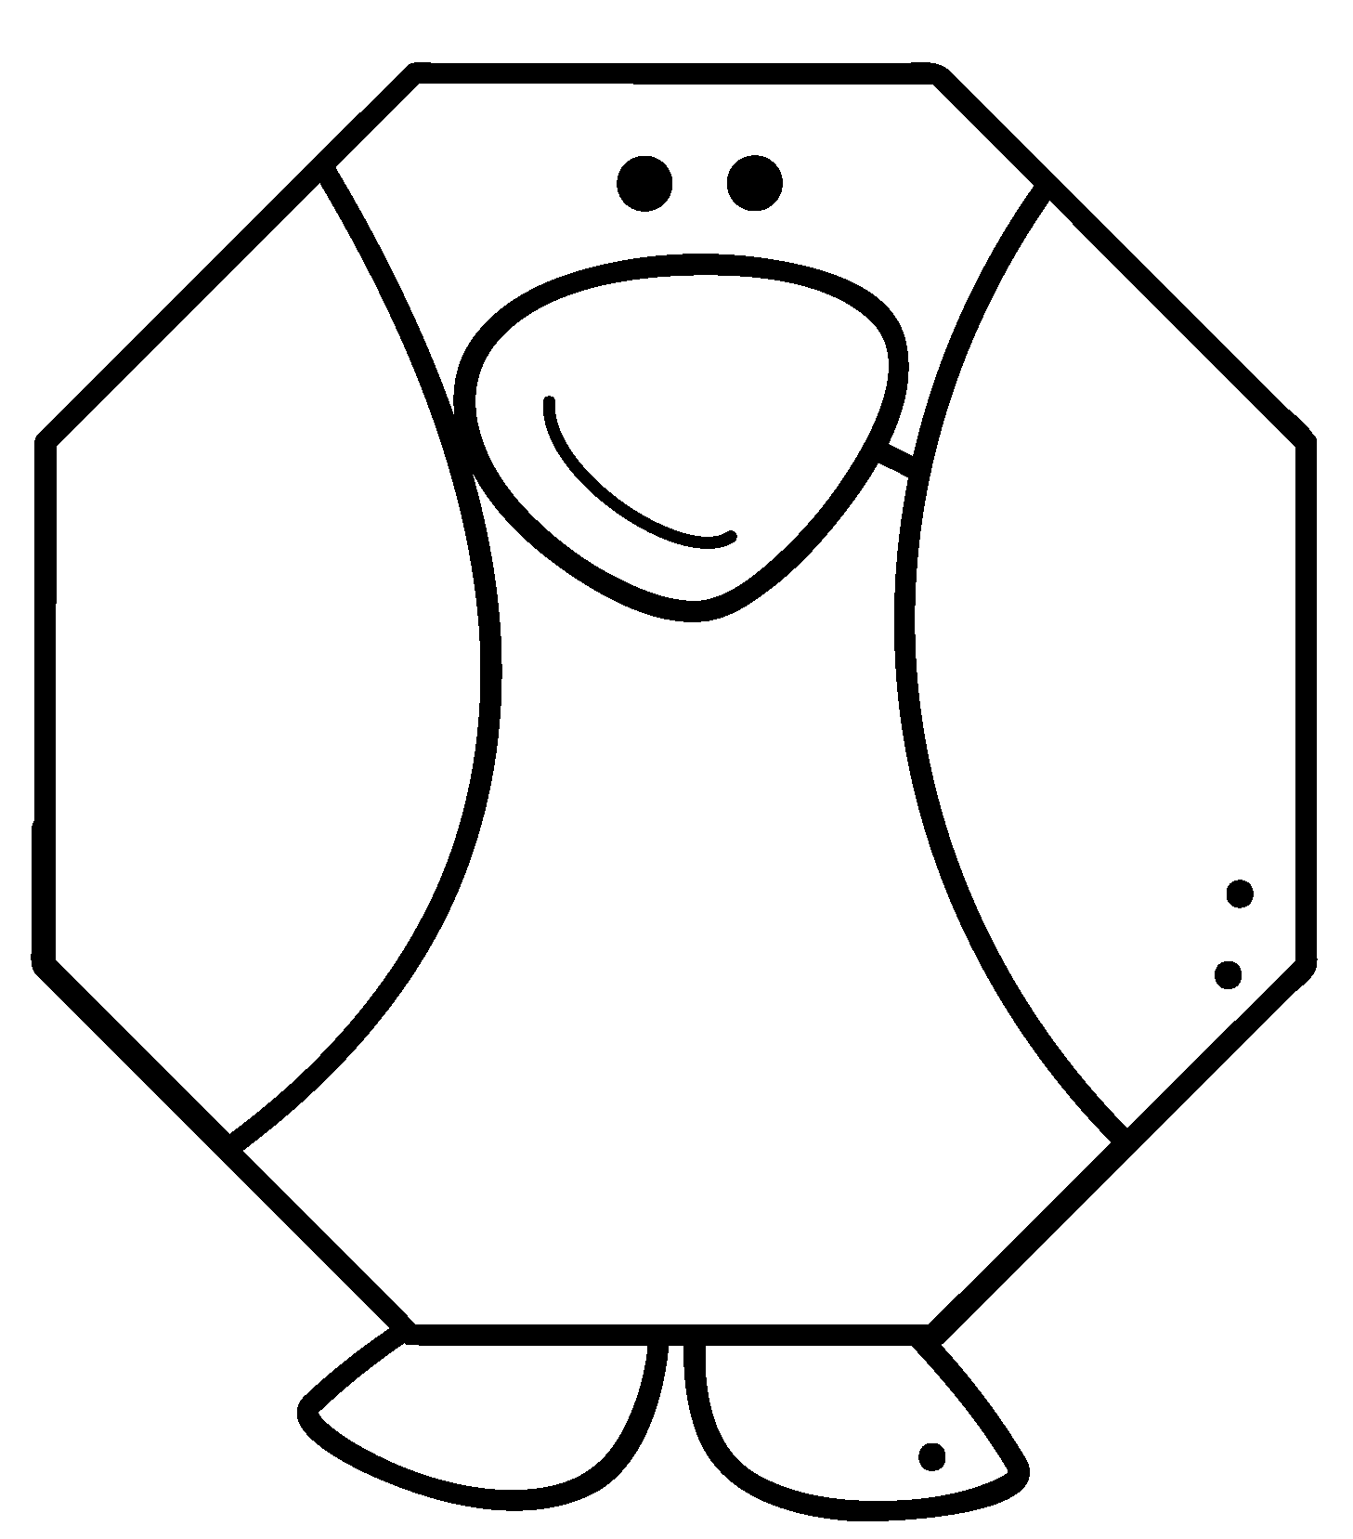
Exploring Shapes with Penguins Book 1 in the Penguin Books Series Created by Deirdre Smith of JDaniel4’s Mom Clip Art from
Terms of Use: These printables are provided FREE of charge. Please do share the web pages to my printables. Remember that all of my printables are for personal use. You cannot claim these printables or sell them as your own. All the printables are the property of JDaniel4sMom.com

Slide 2
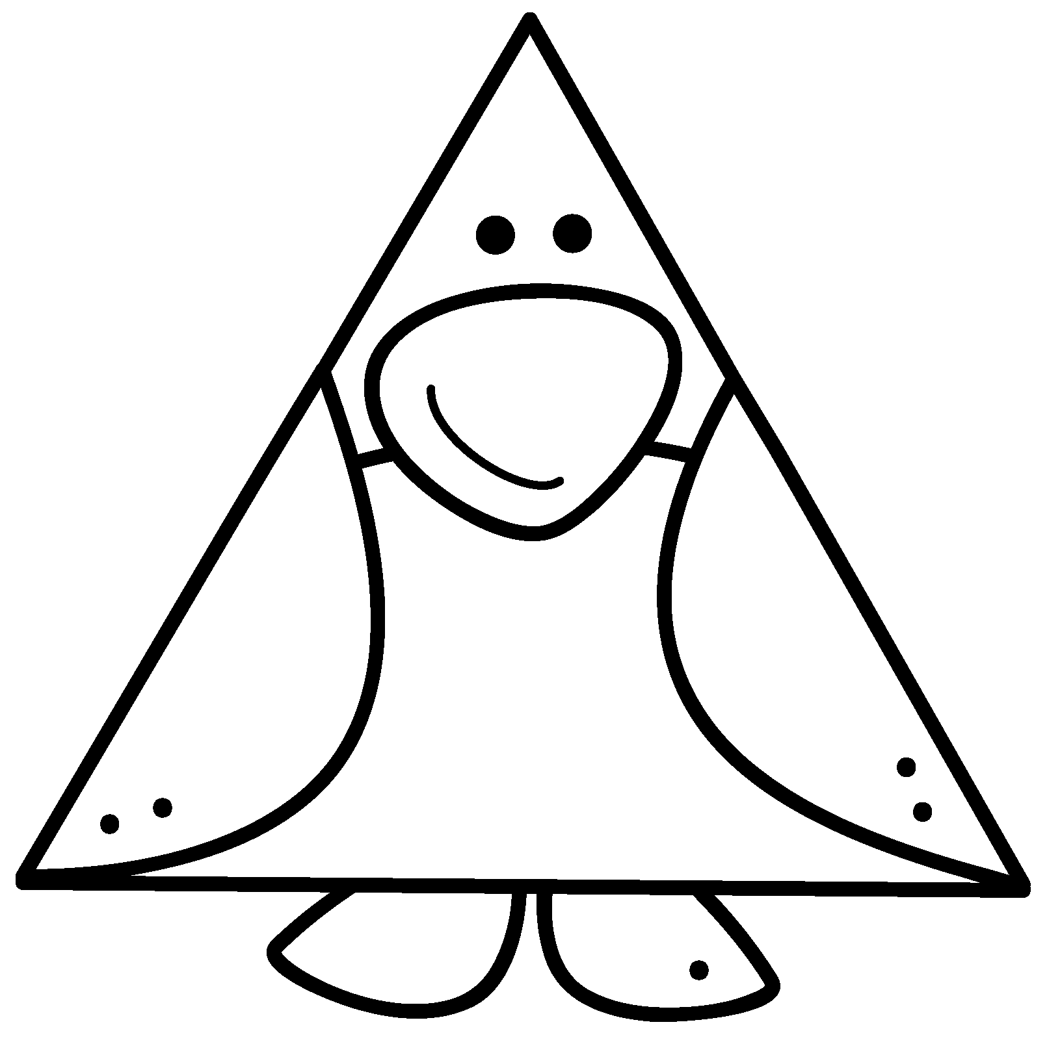
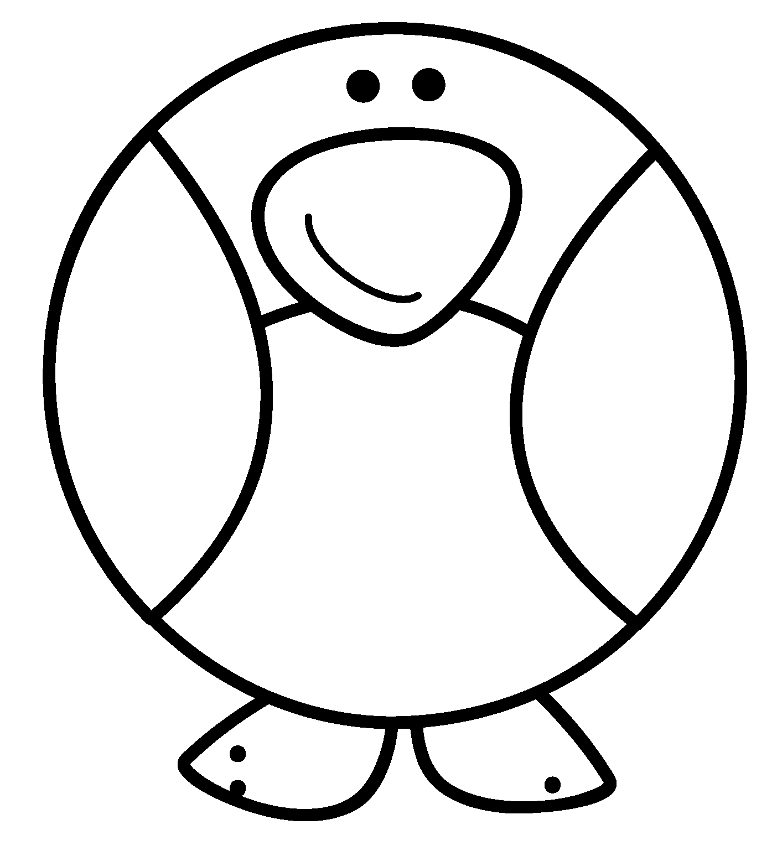
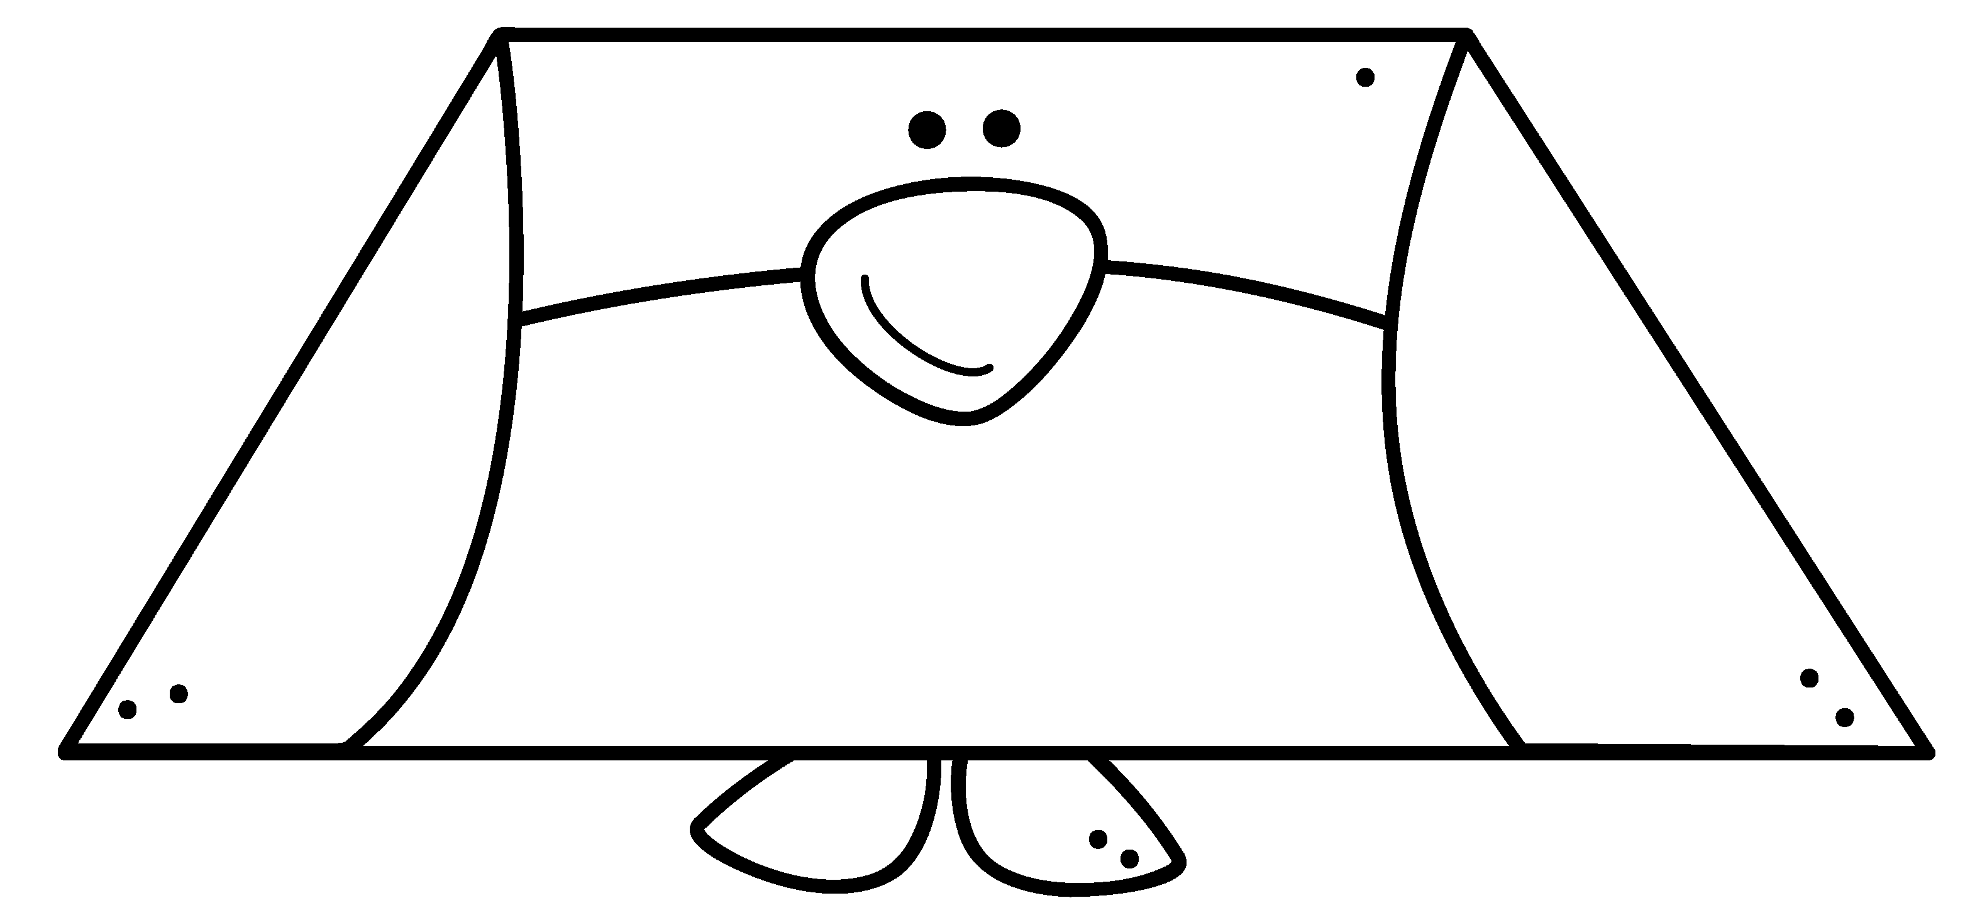
Triangle
Rectangle
Square
Circle
Octagon
Exploring Shapes with Penguins
Oval
Trapezoid
Created by JDaniel4sMom.com

